Slide 1
FUZZY LOGIC hybrid solar inverter controller for photovoltaic applications (fli)
Majd Abou Assy Joelle Daou Pierre El Hachem Elie Nakhle Fouad Saba
ESIB Multidisciplinary Project
May, 2022
Supervised by:
Dr. Robert Farha

Slide 2

Project members
Name | Major
Majd Abou Assy | Computer and Communication Engineering
Elie Nakhle | Computer and Communication Engineering
Fouad Saba | Computer and Communication Engineering
Joelle Daou | Computer and Communication Engineering
Pierre El Hachem | Electrical Engineering

Slide 3
Purpose of the project
01
includes the introduction, the aim of the project as well as its expected outcomes, the project management, and related works.
Proposed Solution
02
includes the functional requirements and constraints, the Engineering techniques and skills, and a comparison with alternative solutions.
Results and Analysis
03
includes the testing and improvements as well as the changes that occurred throughout the project.
Conclusion with Demo
04
includes the impact of the solution, a summary of the major achievements, the future improvements, and a live demonstration.

Slide 4






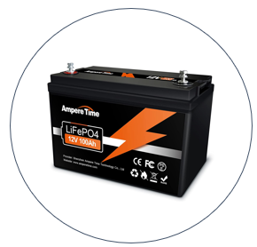
Introduction
Power outages paralyzing Lebanon
The aim of this project is to provide uninterrupted power supply - using four different energy sources - while keeping the total cost at its lowest.

Slide 5
Project Objectives and Outcomes
Implementation of the Fuzzy Logic algorithm based on which the inverter will take the decision.
Mobile Application Development.
Communication between the microcontroller and the application.
CCE Outcome
Setup of the electronic circuit (Arduino board with various sensors).
Electric Outcome

Slide 6
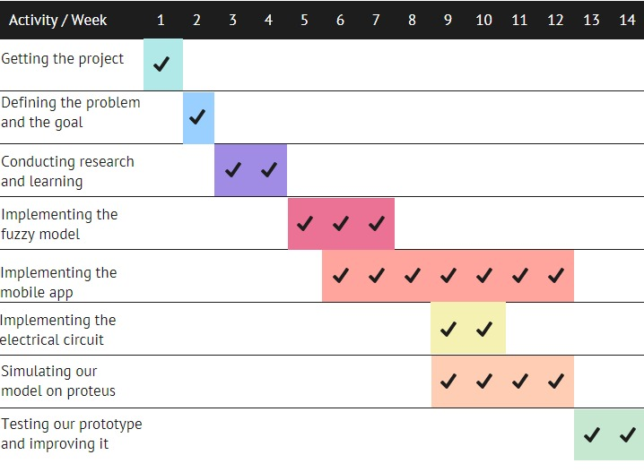
Project Management
Projected Gantt Chart

Slide 7

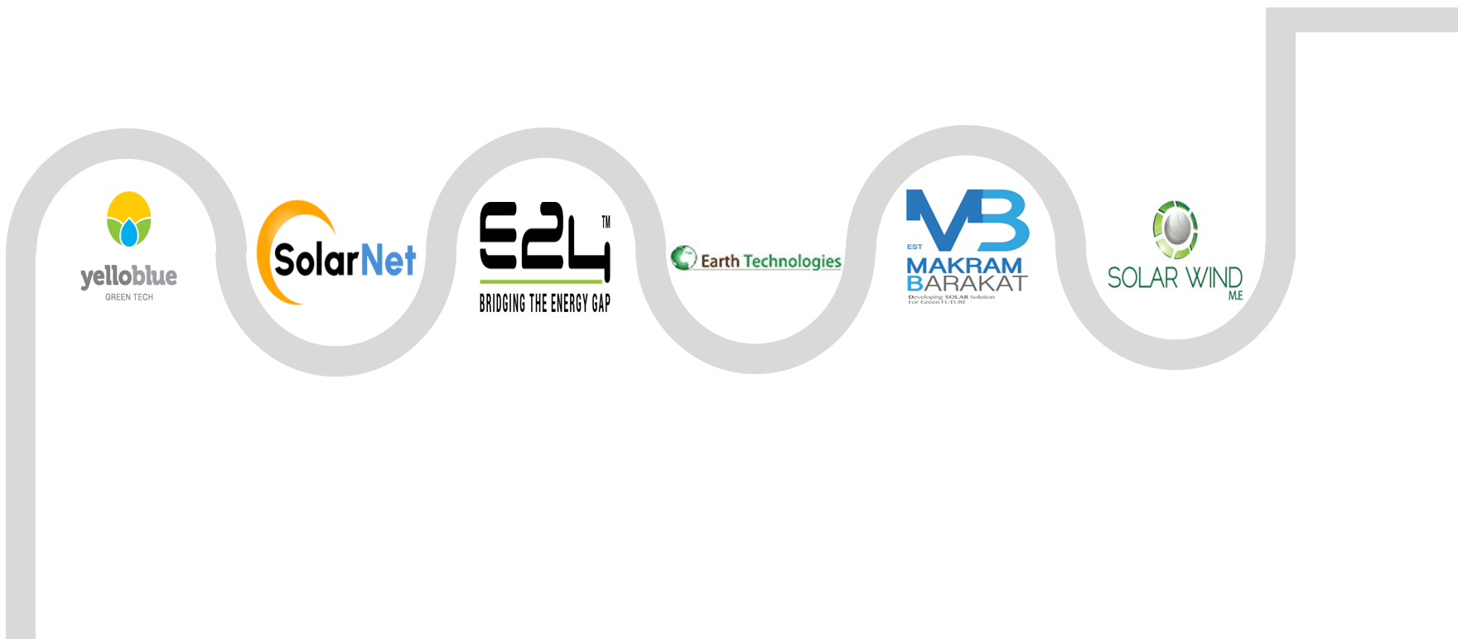
Related Works
However, hybrid inverters cost much lower and are easier to install.
24/7 electricity
There are many solar energy companies in Lebanon, all aiming for a green future.

Slide 8
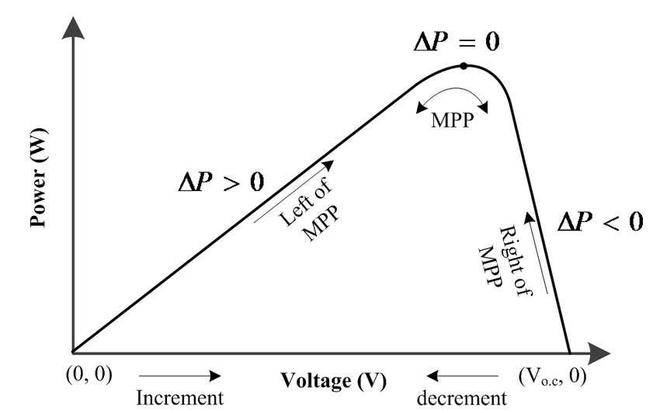
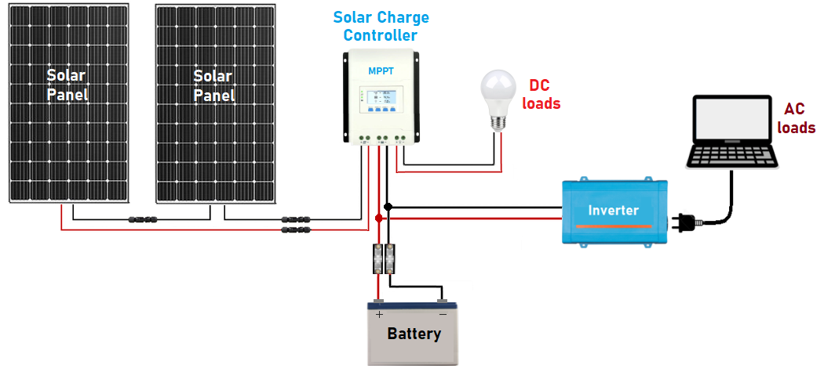
Comparison of Related Works
A very common solar charge controller technique is the Maximum Power Point Tracking (MPPT). It is used to maintain the PV array's operating point at its maximum power point (MPP) and extract the maximum power available in PV arrays.

Slide 9

Born from the specific arising case of Lebanon, our research had to be done for the first time ever.
Customized solution
Existing solutions

Slide 10



Project Functional Requirements
Telecommunication aspect
A Python library (Pyrebase) will ensure the communication between the microcontroller and the application.
Hardware aspect
Software aspect
It consists of various sensors connected to the Arduino Mega 2560.
A developed algorithm based on fuzzy logic will let the inverter choose the convenient energy source to use at a given time.
A mobile application (Flutter + Firebase) is the way to inform the clients about these decisions.

Slide 11





Project Constraints
Multiple electricity sources
These sources might be difficult to access due to the lack of equipment and its high cost.
Time
Sustainability of the design
The project must be ready within a period of three months.
It must be reliable, durable, and should survive the diverse conditions.
Environment
Lack of information
To have a trained data set, several weather conditions must occur.
Due to the absence of earlier study in this sector, there is a shortage of information.

Slide 12





Proposed Solution
Techniques for Engineering Practice
1
Software part
03
Such as the availability of the EdL and the generator and their functionalities.
01
03
05
Inputs
Inputs
04
02
Parameters
Parameters
MATLAB
Low, medium, and high parameters.
MATLAB
04

Slide 13
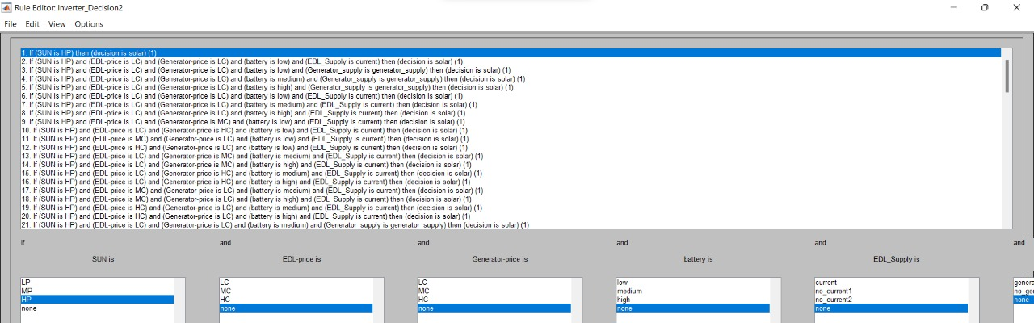
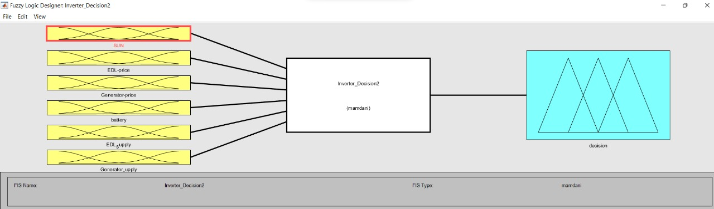
Proposed Solution
Techniques for Engineering Practice
1
Software part
Inverter decision
Inputs
Parameters
The rules were introduced based on which the algorithm had to take the decision.
MATLAB

Slide 14
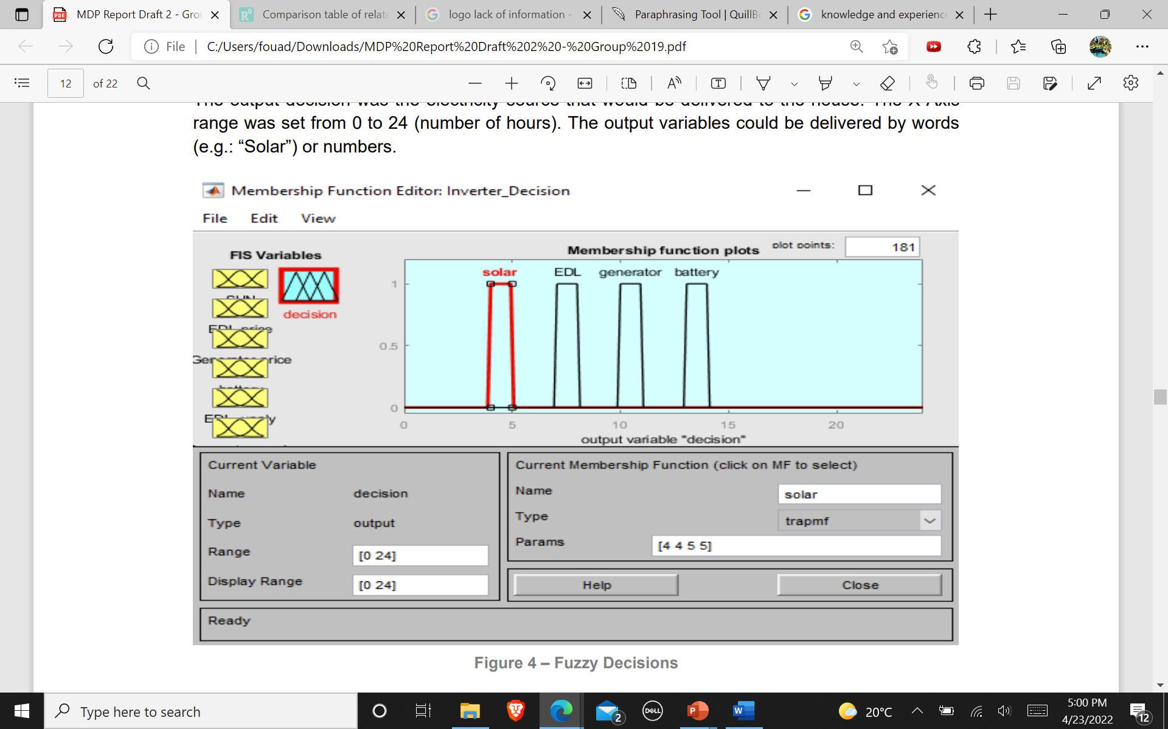
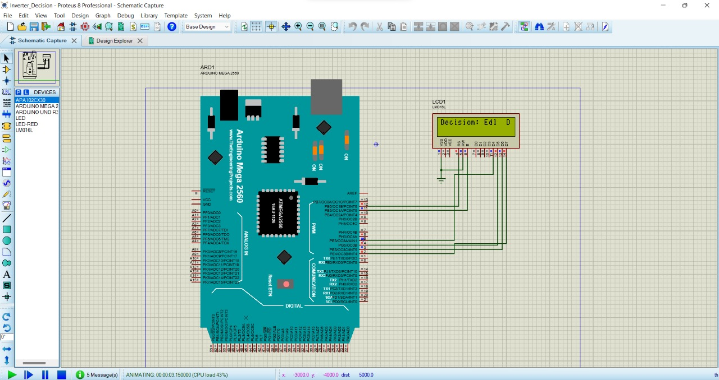
Proposed Solution
Techniques for Engineering Practice
1
Software part
Inputs
Parameters
MATLAB
Proteus simulation

Slide 15


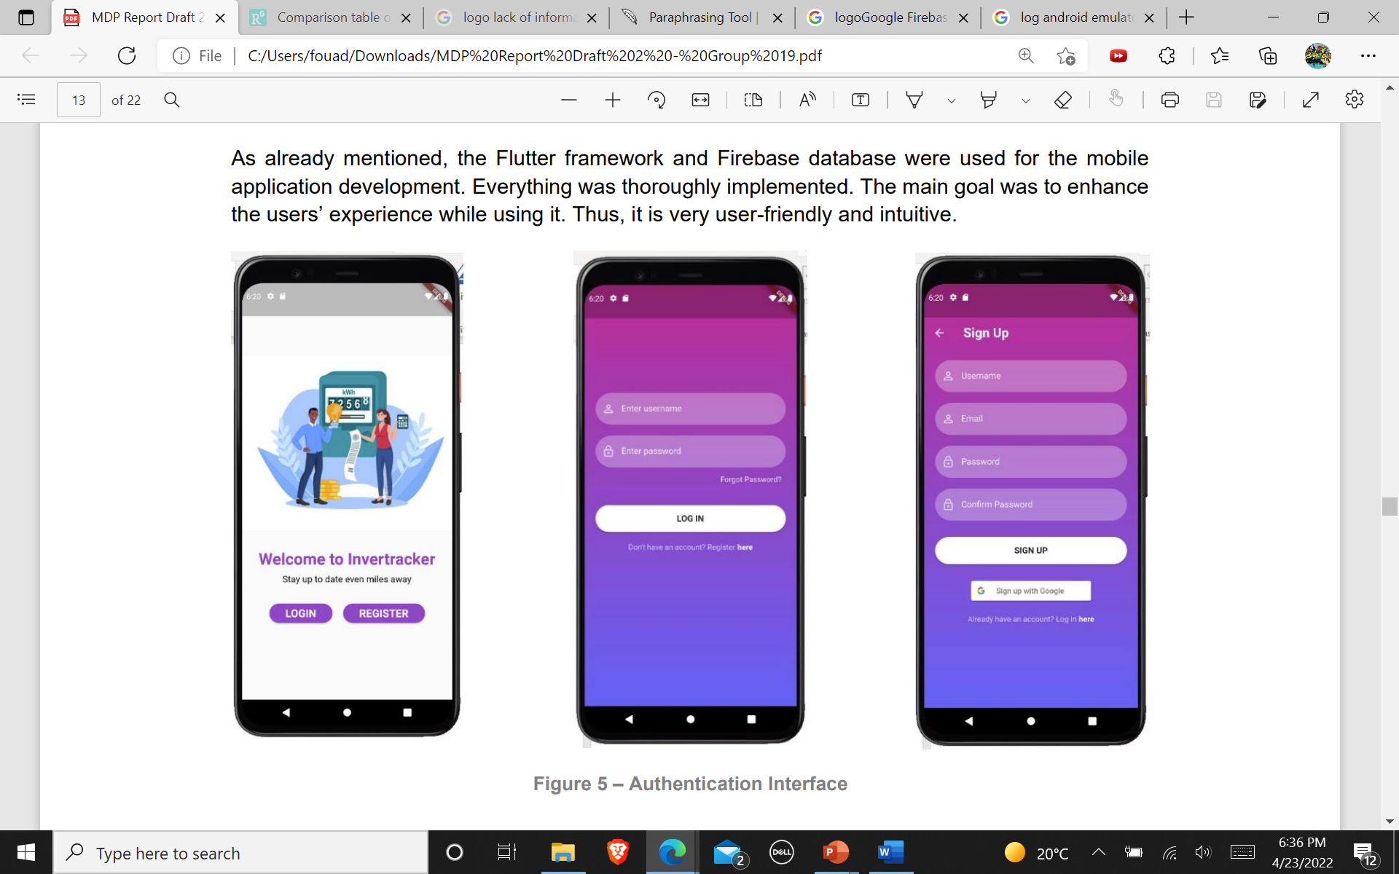





Proposed Solution
Techniques for Engineering Practice
1
Software part
Flutter: an open-source framework.
Powered by Dart.
Inputs
Designed on Visual Studio Code.
Simulated on an Android Emulator.
MATLAB
Firebase: the application’s database.

Slide 16
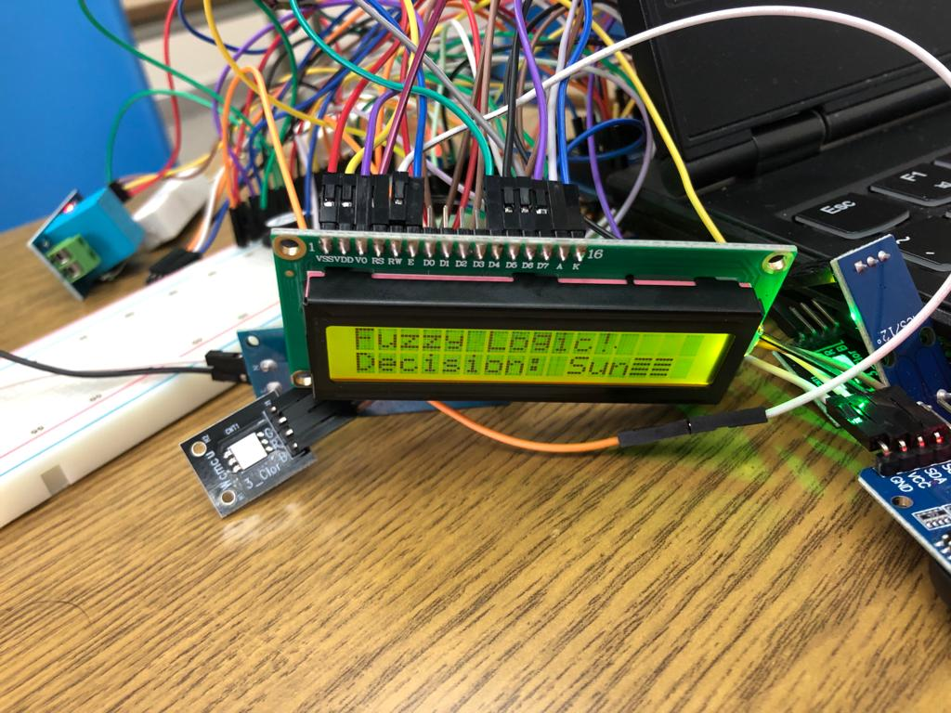
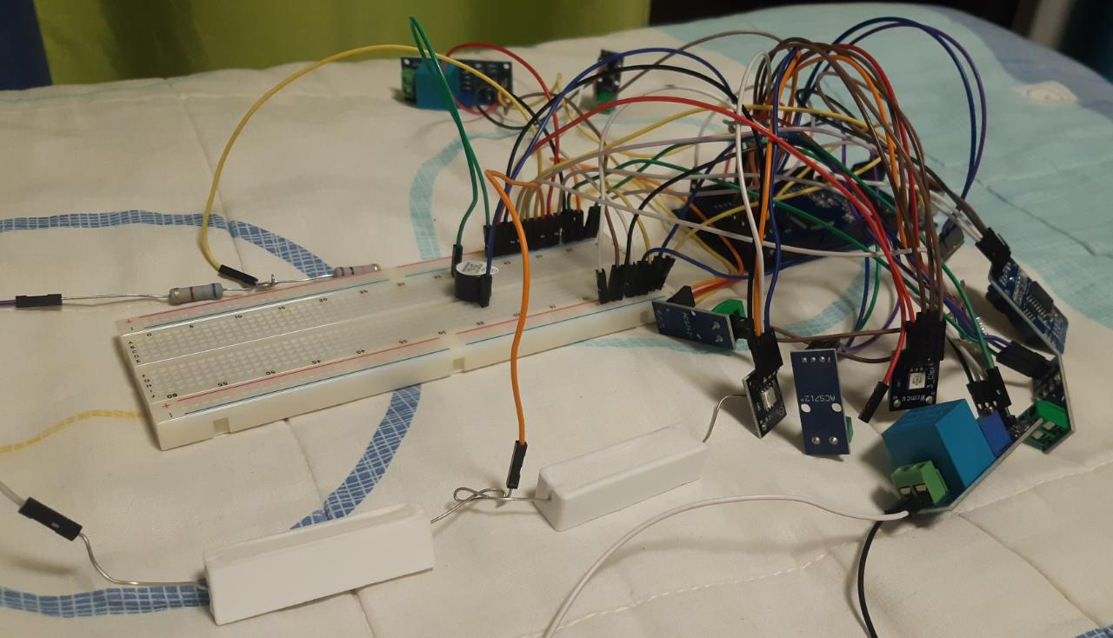
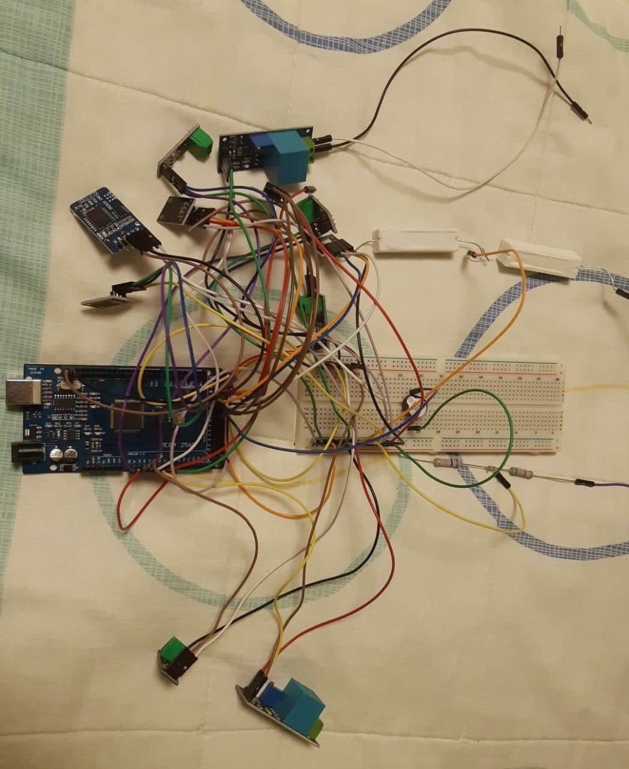
Proposed Solution
Techniques for Engineering Practice
2
Electric part
The sensors were connected to an Arduino Mega 2560 board that tracks the measurement assets.
ESIB-MDP

Slide 17
Proposed Solution
Techniques for Engineering Practice
2
Telecommunication part
The Arduino was connected to Firebase using Pyrebase, a Python library.
01
02
The data collected was encrypted, creating a Realtime database.
The data was retrieved by the application.
03
04
The data was added to the correct field so that the users could visualize it.
ESIB-MDP

Slide 18










Proposed Solution
Skills for Engineering Practice
2
TM
Arduino
ESIB-MDP

Slide 19
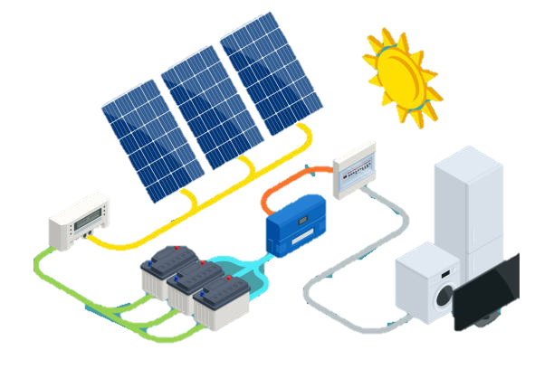
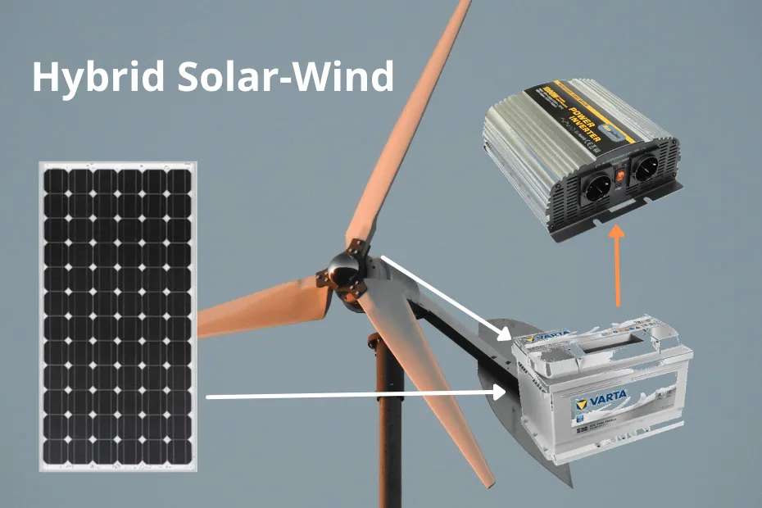
Proposed Solution
Comparison with Alternative Solutions
Hybrid controller for PV-Wind-Fuel sources
Both use fuzzy logic algorithm.
Different energy sources.
Significantly higher implementation cost.
Implemented by a team in the electrical department of “Millia Institute of Technology, Purnea, in India”.
ESIB-MDP

Slide 20
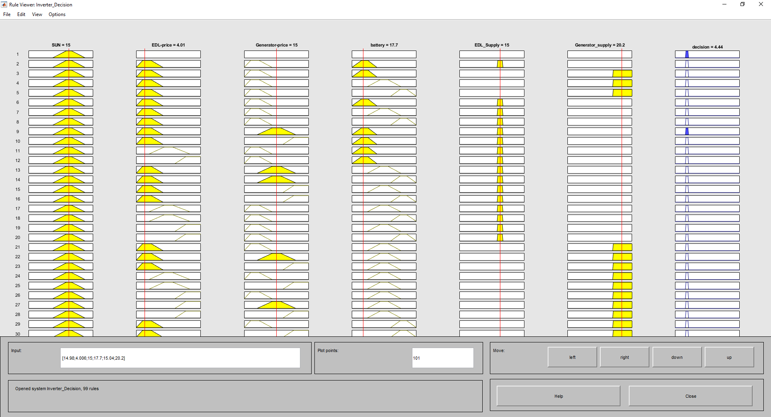
Results and Analysis
Fuzzy rules

Slide 21
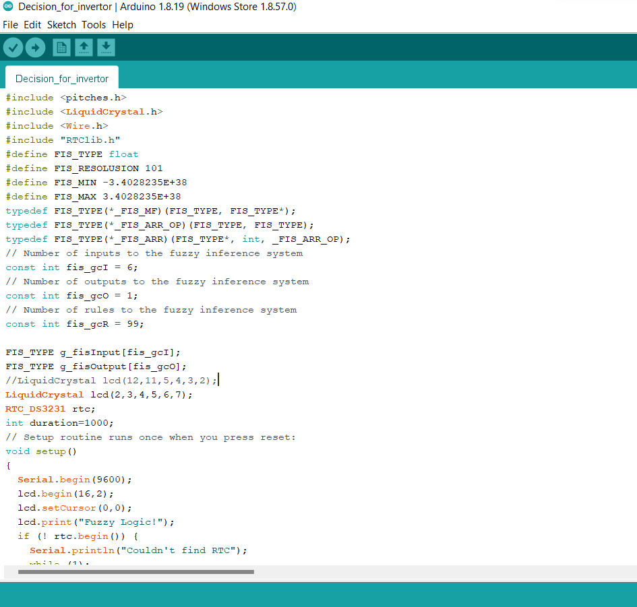
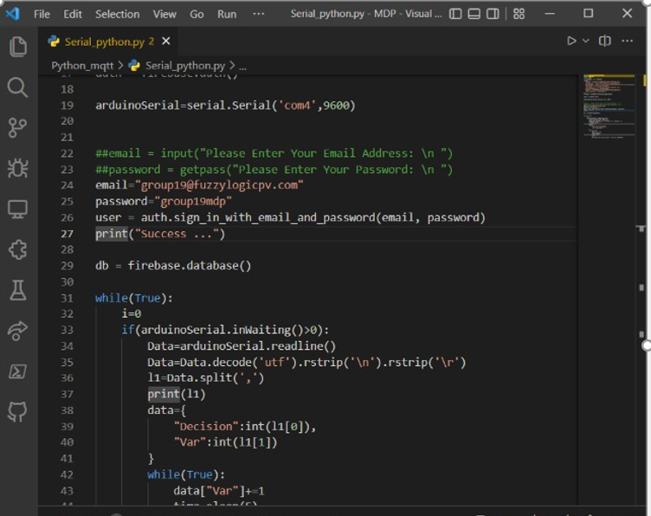

Arduino and python code
FLI CONTROLLER FOR PV APPLICATIONS
21

Slide 22
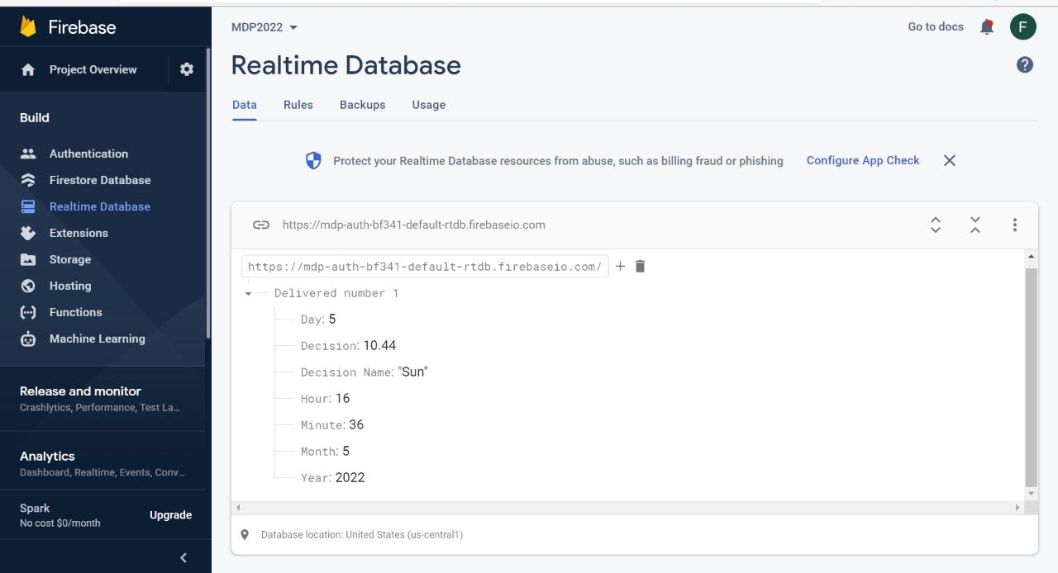

Firebase
22
FLI CONTROLLER FOR PV APPLICATIONS

Slide 23
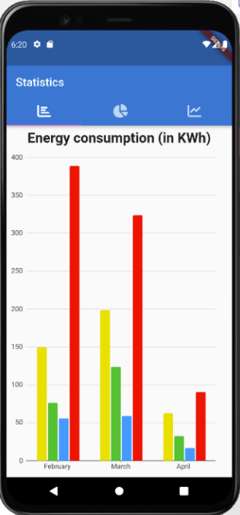
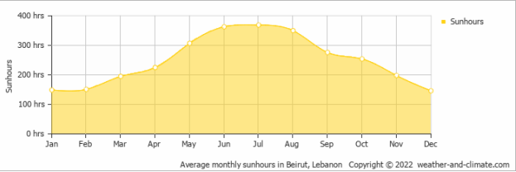
Application level
FLI CONTROLLER FOR PV APPLICATIONS
ESIB-MDP
23

Slide 24
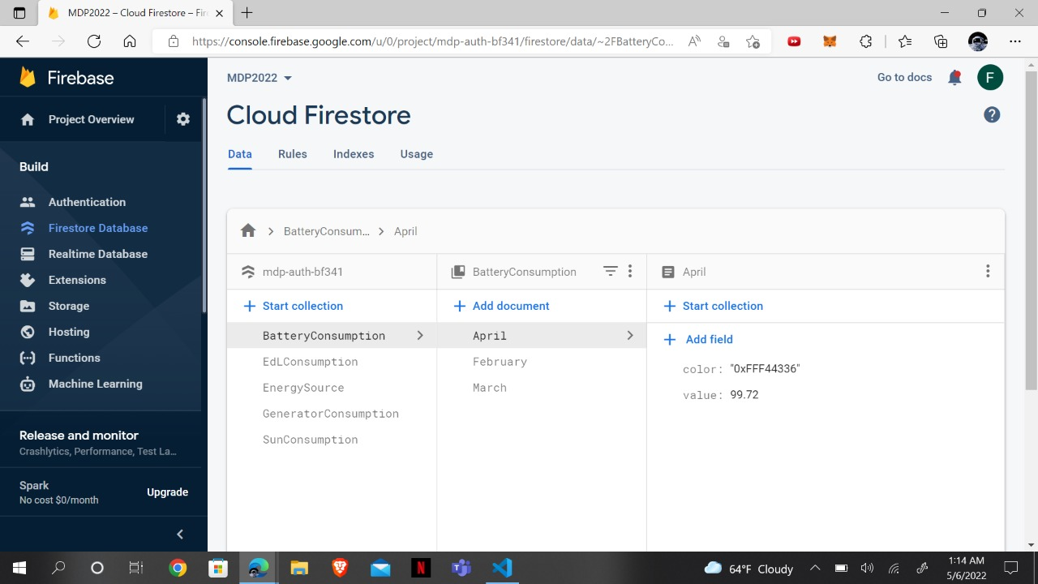
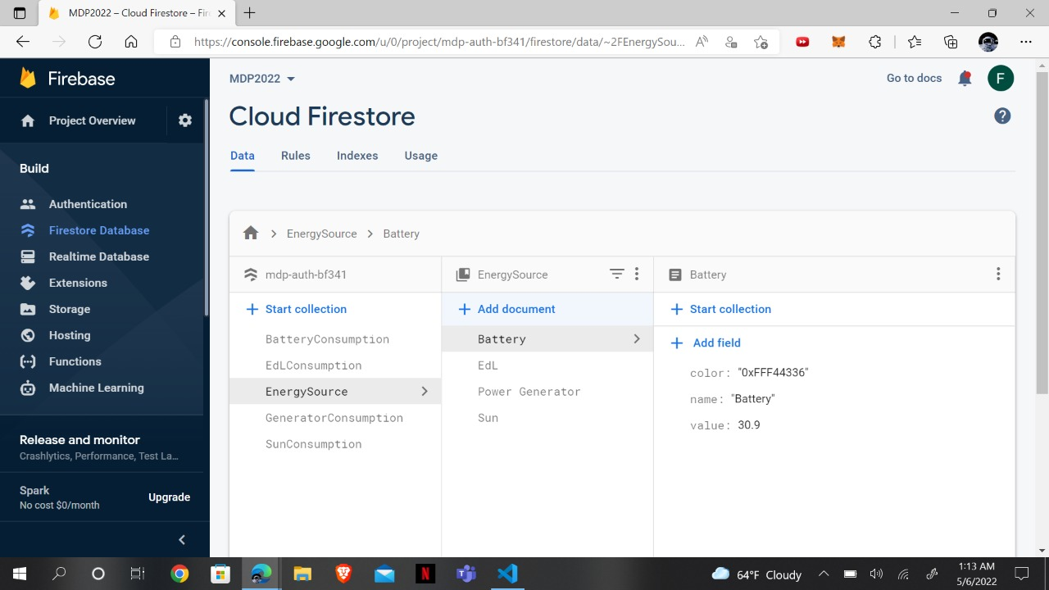
ESIB-MDP
FLI CONTROLLER FOR PV APPLICATIONS
24

Slide 25
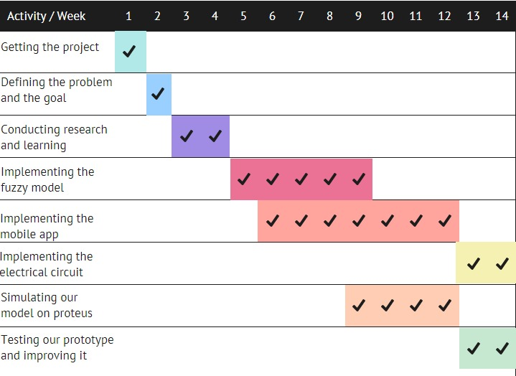
Changes in Project Management
2 more weeks for the algorithm
Delay in the electric circuit
Executed Gantt Chart

Slide 26
Solution Impact
Societal context
Provide 24-hour electricity
Economical context
Minimal cost
Environmental context
The solution turns out to be eco-friendly

Slide 27
Conclusions
An intelligent fuzzy logic design
Effectively choosing the appropriate energy source
Successfully implementing the mobile app
High importance since no prior study has been made

Slide 28
Perspectives
Machine Learning
Neural Network
Fuzzy Logic Algorithm
Increasing the number of rules
Mobile Application
Adding new features and options

Slide 29
References
[1] S. Jaadari and H. Battah, «Lebanon’s electricity crisis means life under candlelight for some, profits for others,» The World, 22 November 2021. [Online]. Available: https://theworld.org/stories/2021-11-22/lebanon-s-electricity-crisis-means-life-undercandlelight-some-profits-others.
[2] «Fuel crisis in Lebanon potential catastrophe for thousands: senior UN official,» United Nations, 17 August 2021. [Online]. Available: https://news.un.org/en/story/2021/08/1097962.
[3] A. Di Carlo et al., «Photovoltaics,» EPJ Web of Conferences, Vols. %1 sur %2246, 2020, n° %1EPJ Web Conf., p. 32, 2020.
[4] M. Braae and D.A. Rutherford, «Theoretical and linguistic aspects of the fuzzy logic controller,» 19 June 1978. [Online]. Available: https://www.sciencedirect.com/science/article/abs/pii/0005109879900050. [Accessed Feb. 10, 2003].
[5] L. Scalaberot et al., «A relative power-based adaptive hybrid model for DC/AC average inverter efficiency of photovoltaics systems,» 15 April 2018. [Online]. Available: https://www.sciencedirect.com/science/article/abs/pii/S1364032118303137. [Accessed May. 9, 2018].
[6] S. Lalouni et al., «Modeling and Simulation of a Photovoltaic System Using Fuzzy Logic Controller,» IEEE, 14-16 December 2009. [Online]. Available: https://ieeexplore.ieee.org/document/5395084. [Accessed Jan. 22, 2010].
[7] S. Kjaer et al., «Design optimization of a single phase inverter for photovoltaic applications,» IEEE, 15-19 June 2003. [Online]. Available: https://ieeexplore.ieee.org/document/1216616. [Accessed Aug. 04, 2003].
ESIB-MDP
FLI CONTROLLER FOR PV APPLICATIONS
29

Slide 30

ESIB-MDP
FLI CONTROLLER FOR PV APPLICATIONS
30

